Slide 1
Finding the Best City to Enjoy a Bacon Egg and Cheese
By: Videsh Narine

Slide 2
Being able to find the best city to enjoy an American classic is important to tourists who want to have the best time possible
New York has such a rich and diverse culture being a mix of many different types of people from every color, creed, and ethnicity. This is one of the reasons New York City is one of the most romanticized and popular cities in the US.
Another city that has the same status as New York would be Los Angeles where the bacon egg and cheese scene is big over there.
Because of the high status of these cities, tourists would love to know where to best spend their time.

Slide 3
Data acquisition and cleaning
The dataset was taken from Four Square’s API which includes a vast amount of geographical and location data, the category ID used for delis was: 4bf58dd8d48988d146941735
What this does is allow search in the dataset to only give information about delis
There are 252 delis in New York while there are 225 delis in Los Angeles
Out of all the data only the name, address, Latitude and Longitude was used as columns

Slide 4
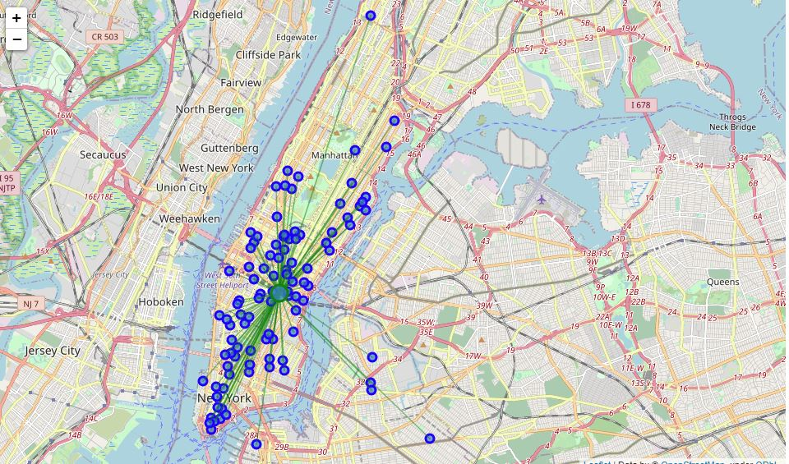
Delis spread across New York

Slide 5
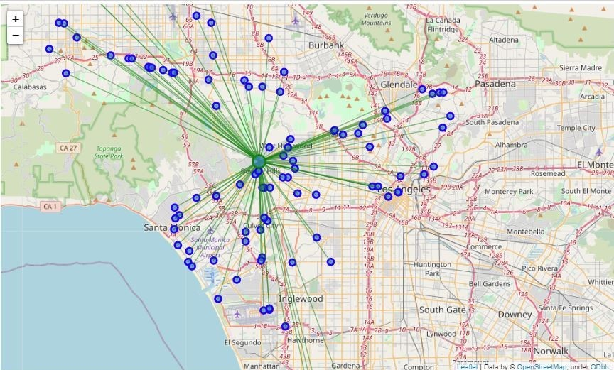
Delis spread across Los Angeles

Slide 6
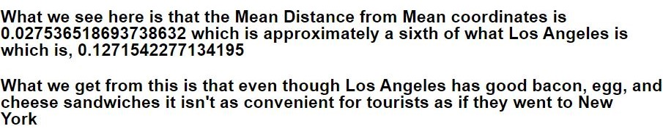
Results

Slide 7
Conclusion
There are more delis in New York than Los Angeles as well as the fact that the deli’s in New York are much more densely occupied.
Further steps, include
Including mom and pop shops as well as any other restaurants that serve the sandwich because as new restaurants emerge, we never know what will be on the menu. Therefore this must keep updates to keep tourists up to date with the establishments around them if they visit either city.

